Slide 1
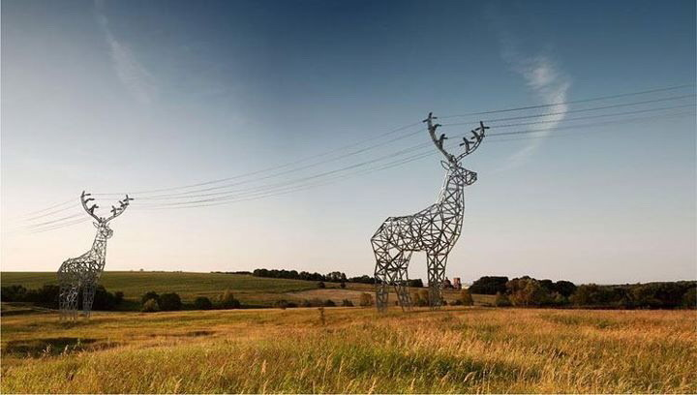
Energizing opportunities
פתרונות וחידושים במערכות מתח גבוה נטולות SF6
We make what matters work.
Notes:
At Eaton, we believe that we owe it to future generations to leave the world a little “greener”. And the power to make that happen is in our hands. That means all of us, working together.
As one of the world’s leading global technology companies, Eaton is committed to positively impacting the environment while helping to solve the world’s most pressing power management challenges. By giving people tools to use power more efficiently. Helping companies do business more sustainably. And by encouraging each and every employee at Eaton to think differently about our business, our communities—and the positive impact we can have on the world.
This is what truly matters. And with dedication, smart thinking and new, innovative approaches to some really big problems, we can make it work.

Slide 2
How damaging is SF₆ to the environment?

Slide 3
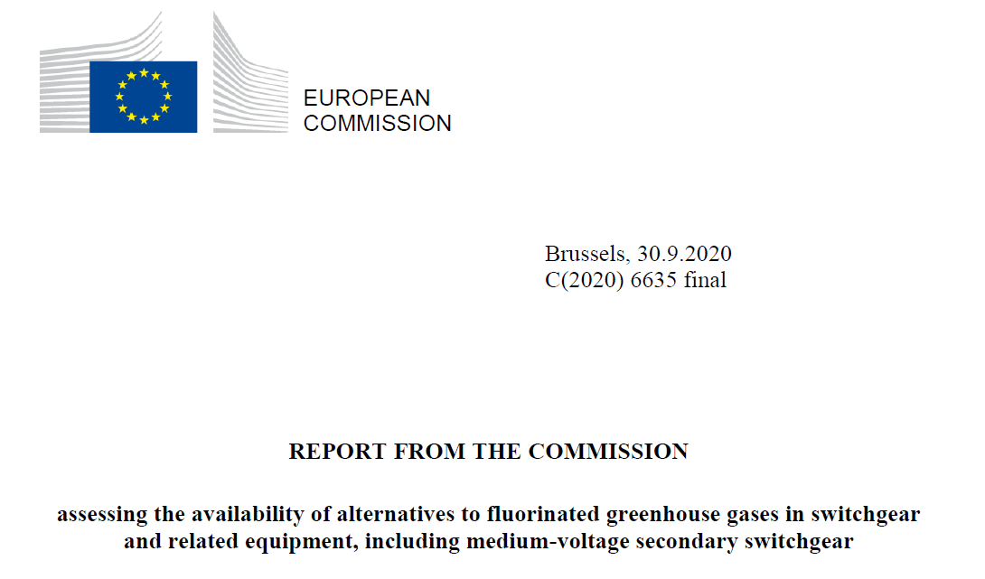

Slide 4
The future of SF₆ switchgear
Sept 2020, due to Regulation (EU) No 517/2014, Article 21(4), the European Commission published a report assessing whether cost-effective, technically feasible, energy-efficient and reliable alternatives exist, which make the replacement of fluorinated greenhouse gases possible in new medium-voltage secondary switchgear
Eatons reaction
Eaton welcomes the Report as an important contribution to the available evidence on SF6 gas usage and the opportunity for replacing it in electrical switchgear. The Report correctly signals the need for an early phase- out of SF6 (by 2025) and the need for policy intervention to ensure that the right incentives are put into place for a rapid uptake of SF6 alternatives.

Slide 5



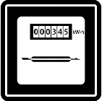


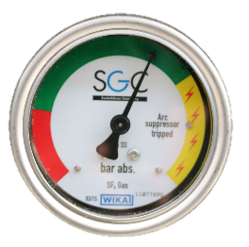

Total Cost of Ownership considerations for SF₆ switchgear
Fuses produce 10x more watt loss (heat)
Replacement cost for fuses
~30% more parts to store & maintain v alternatives
SF₆ pressure inspection
SF₆ refill
SF₆ administration
SF₆ processing
Advanced training for employees
High level of PPE
End of life recycling
Neutralising toxics
  ~10-15% CAPEX cost
Purchase
Recycle /
Disposal
Commissioning
TCO
Dismantling
Energy
use
De-
commissioning
Inspection /
Maintenance
Upgrade

Slide 6
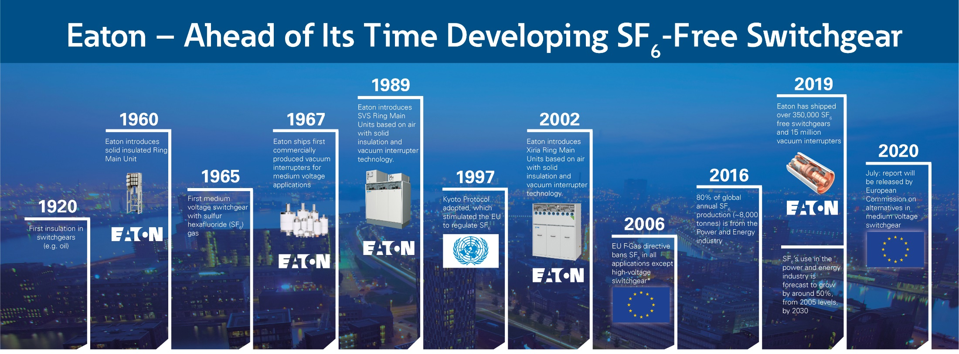
Ahead of our time

Slide 7
IEC 62271-200 Switchgear
Definitions:
LSC Category – Loss of Service Continuity
Partition Class
IAC – Internal Arc Class

Slide 8
1 - Loss of Service Continuity (LSC)
Classification | Description
LSC1 | This form is NOT intended to provide service continuity during maintenance (if needed) and may require complete disconnection of the switchgear from the system and making dead before accessing the interior of the enclosure.
LSC2A | This form is intended to allow maximum continuity of service of the network during access to the compartments inside the switchgear. When accessing components of one functional unit, the other functional units of the switchgear may be kept in service, BUT NOT CABLES
LSC2B | In addition to the LSC2A class, in this category LSC2B the incoming MV-cables to the functional unit being accessed may be kept energized. This means that there is another point of disconnection and separation, i.e. between switching device and cables
LSC1
LSC2A
LSC2B
1
Low Voltage compartment
1
2
1
2
1
2
Main Busbar compartment
3
Circuit breaker compartment
2
3
4
4
Cables compartment
3
4
3
4

Slide 9
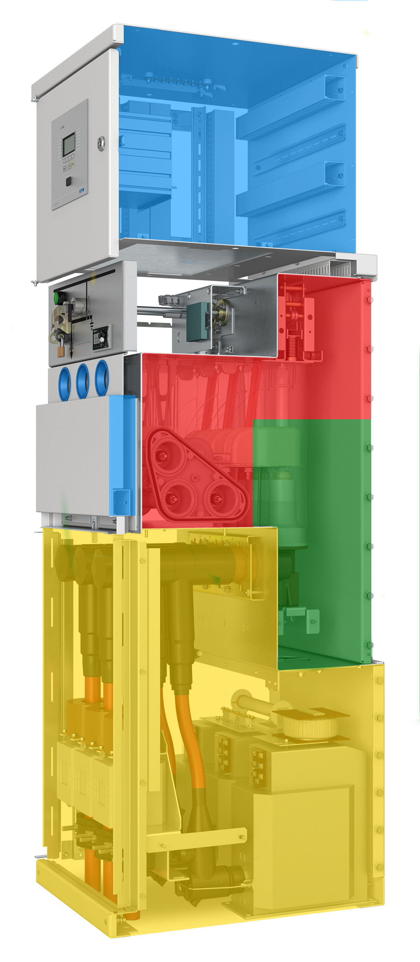
2 - Partition class
Classification | Description
PM | Metallic shutters and partition between live parts and open compartment – (Metal enclosed condition maintained).
PI | Insulation-covered discontinuity in the metallic partitions/shutters between live parts and open compartment).
1
Low Voltage Compartment
2
Main Busbar compartment
3
Circuit breaker compartment
4
Cables compartment

Slide 10
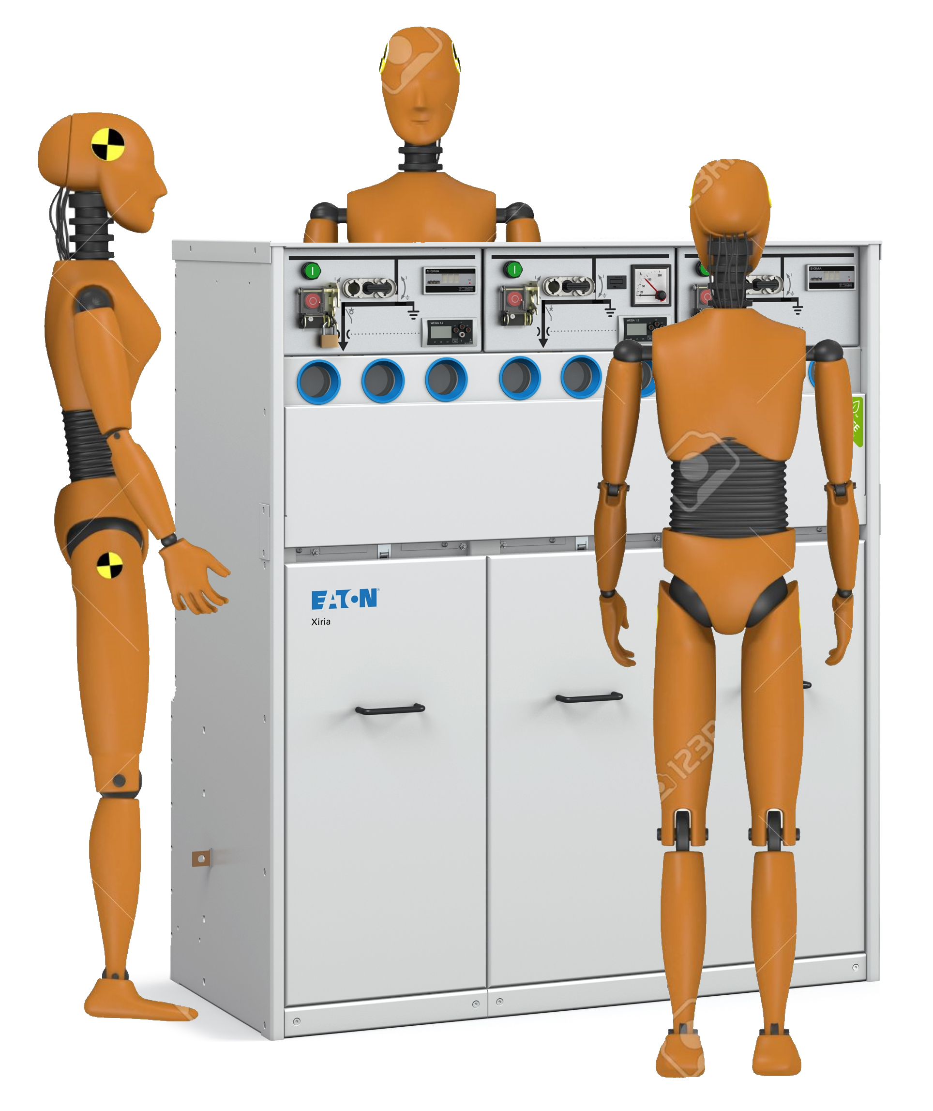
3- Internal Arc classified (IAC)
Rear
Classification | Description
IAC | No ejection of parts, no ignition of cloths, enclosure remains earthed
Accessibility | A: authorized personnel B: General public C: Out of reach, but above general public area
Sides | F: Front L: Lateral (sides) R: Rear
Type test values | I (kA) – t seg
Lateral
Front
Internal Arc Class specification example: IAC AFLR – 20kA – 1s
Classification IAC gives a tested level of protection of persons under normal operating
It is not concerned with personnel protection under maintenance conditions
Gives indication of safety, does not cover all possible causes

Slide 11
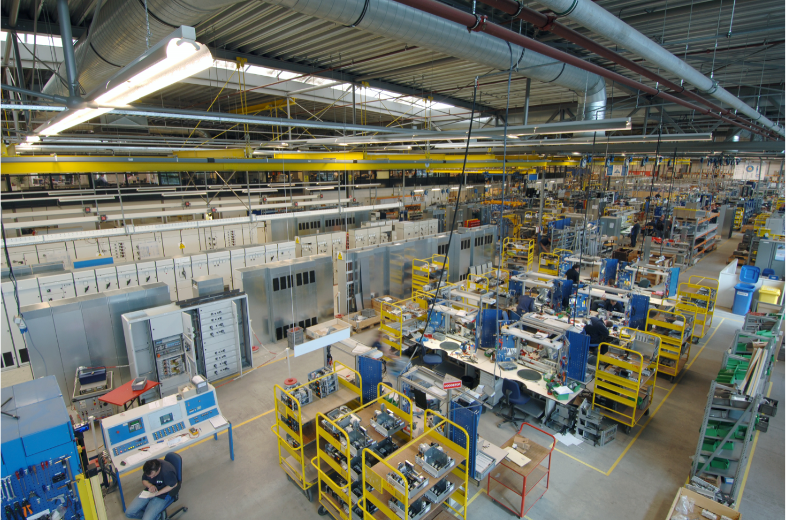
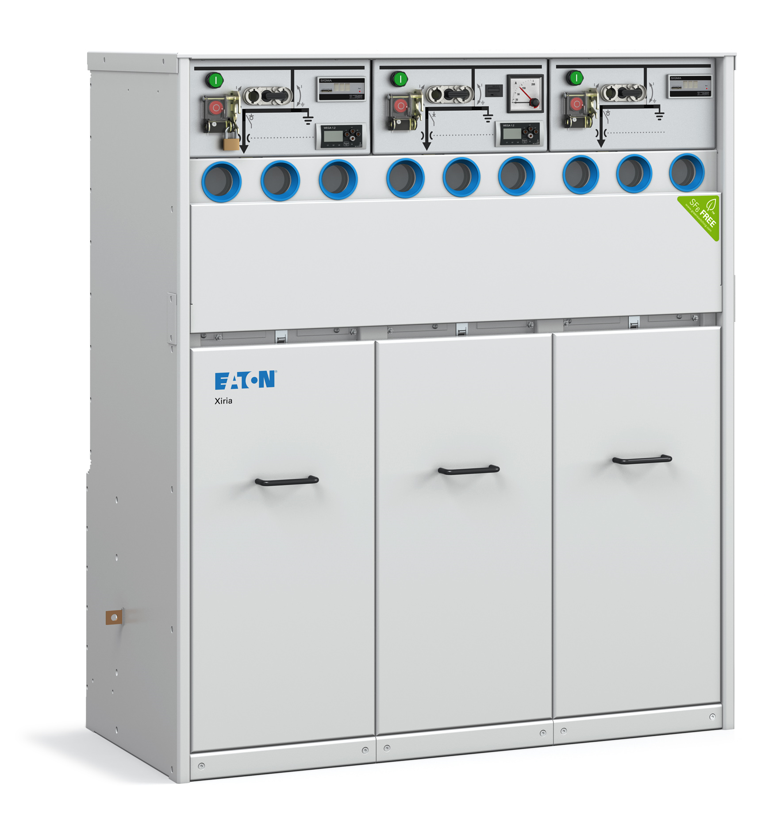
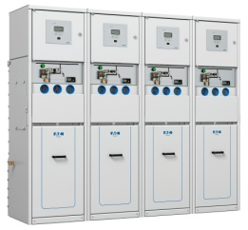
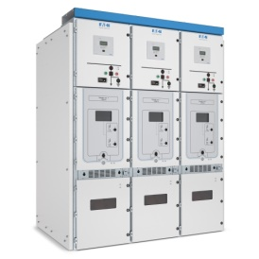
Eaton Primary and Secondary Solution
Hengelo
Xiria – up to 24kV
AIS Secondary Switchgear
Xiria E – up to 24kV
AIS Secondary Switchgear
UX - up to 24kV
AIS Primary Switchgear
Notes:
Some highlights

Slide 12
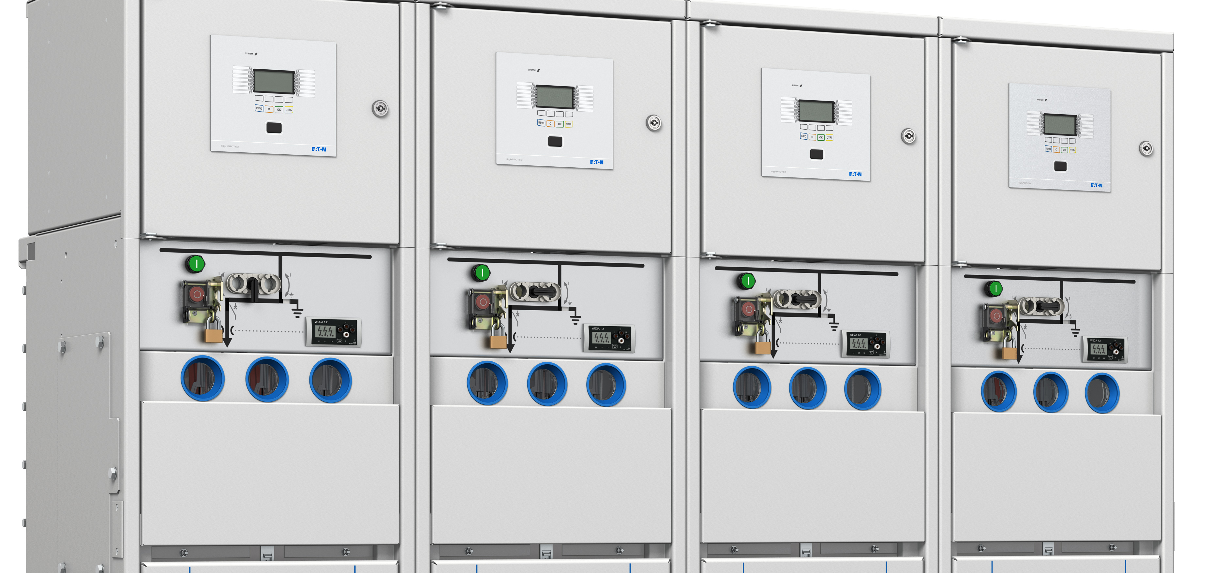
Xiria Product Family

Slide 13
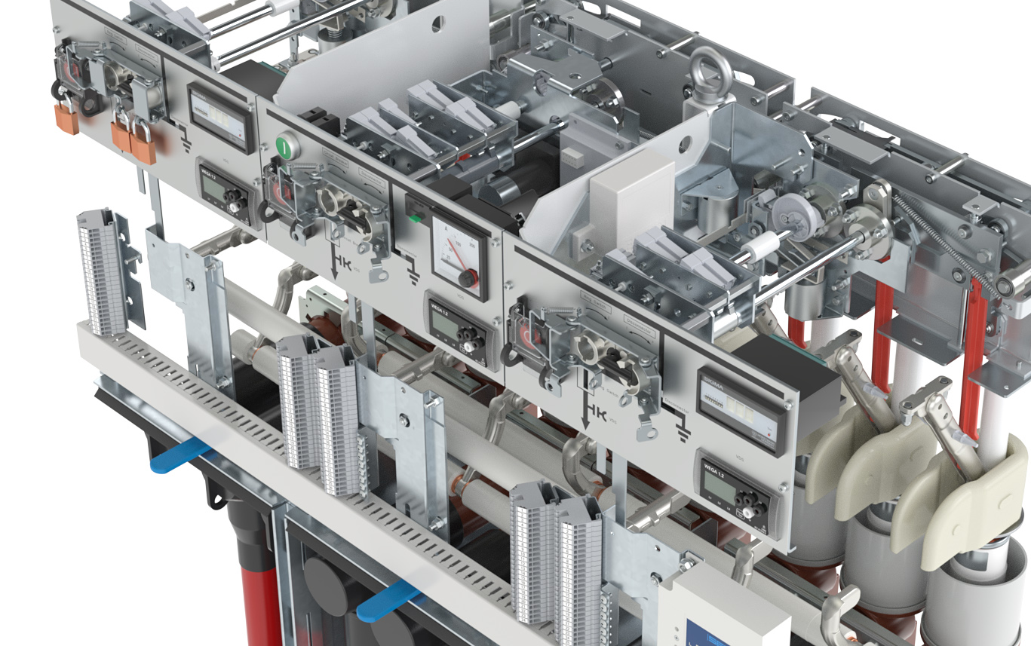
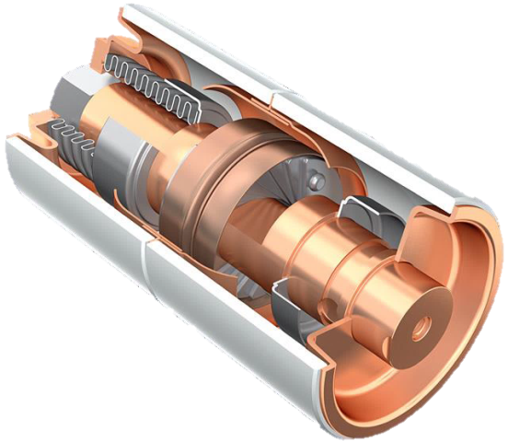
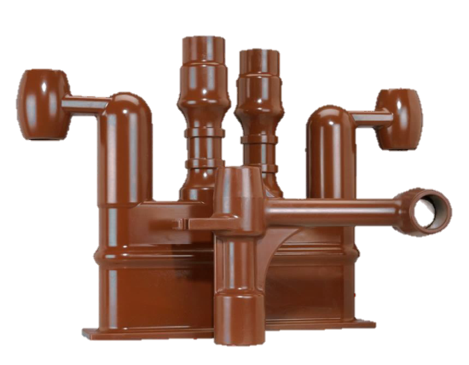
Core competences
Safety, Sustainability and Availability
Arc free design
Arc proof design
SF6 free
System integration
Vacuum
Interrupters
Solid
Insulation

Slide 14
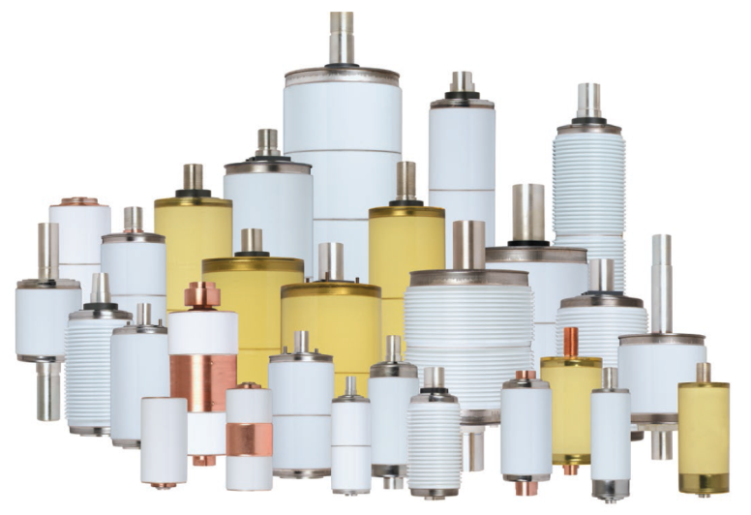
Eaton Vacuum Interrupters
Eaton vacuum Circuit Breakers and Load Break Switches reliably switch currents and require minimal maintenance while enhancing safety
Features & benefits
Safe
Highly reliable
  MTBF: >100,000 years
Maintenance free
> 30,000 mechanical operations
> 100 short-circuit switching operations
Compact

Slide 15

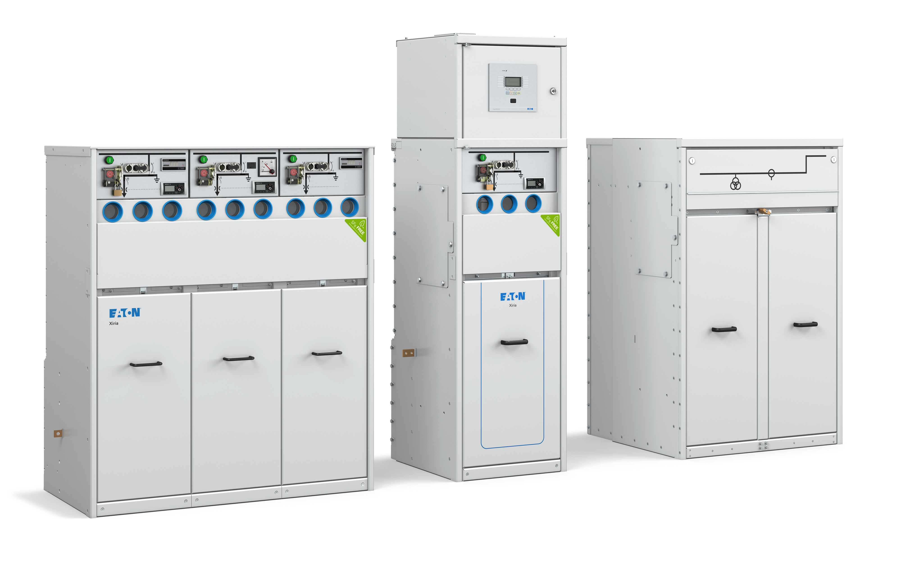
Xiria
Rated Voltage: 24kV
Rated normal Current: 630A
Loss of service continuity: LSC2B
Partition class: PM
Internal Arc Classification (IAC): AFLR 20kA
Xiria complies with the following international standards
IEC 62271-1
IEC 62271-100
IEC 62271-102
IEC 62271-103
IEC 62271-200
IEC 62271-304
IEC 61869-1
IEC 61869-2
IEC 61869-3
IEC 60529
EN 50181
ISO 9001-2015
ISO 14001

Slide 16
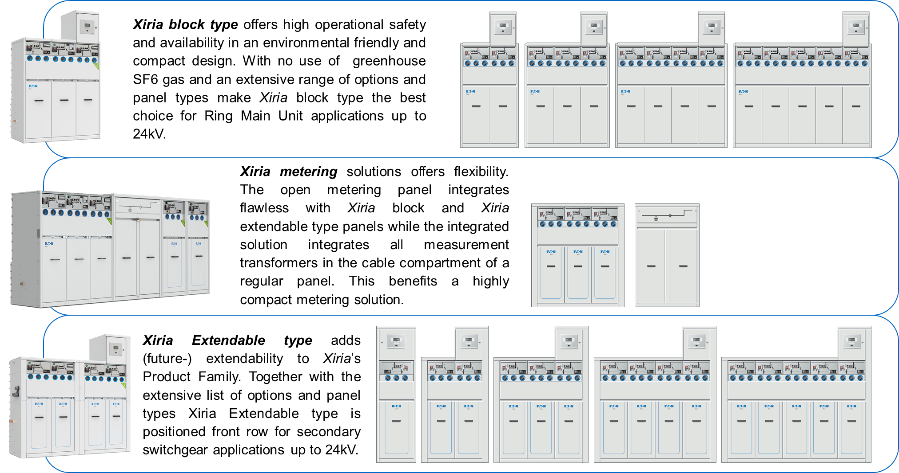
Xiria range

Slide 17
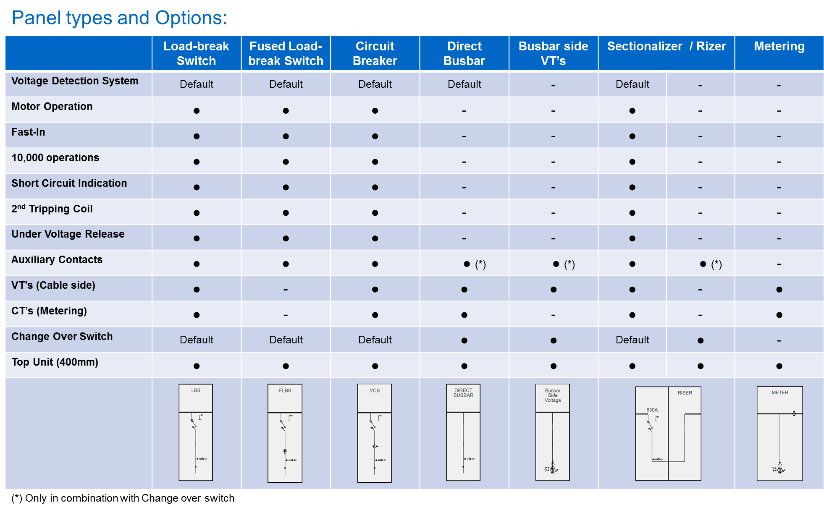
Xiria range: Panel types and Options

Slide 18
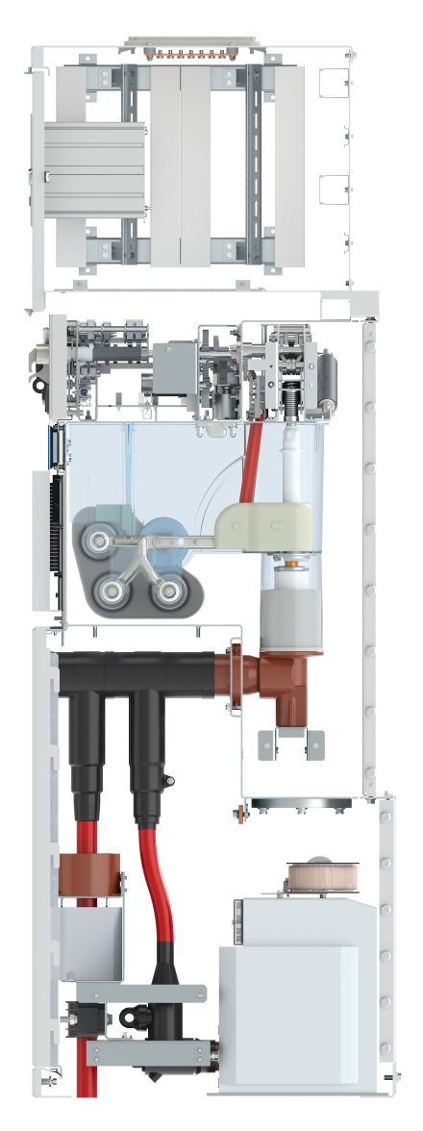
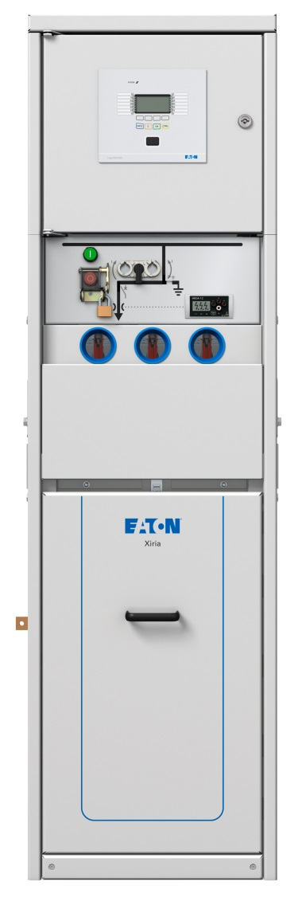
Design
Optional top unit for
advanced protection relay
Intuitive control panel
Trip mechanic
Viewing windows
2-position switch
Low voltage compartment
630A busbar
Vacuum interrupter
Type A or C cone cable connection
Cable compartment door
Current transformer
Cable clamp
Voltage transformer

Slide 19
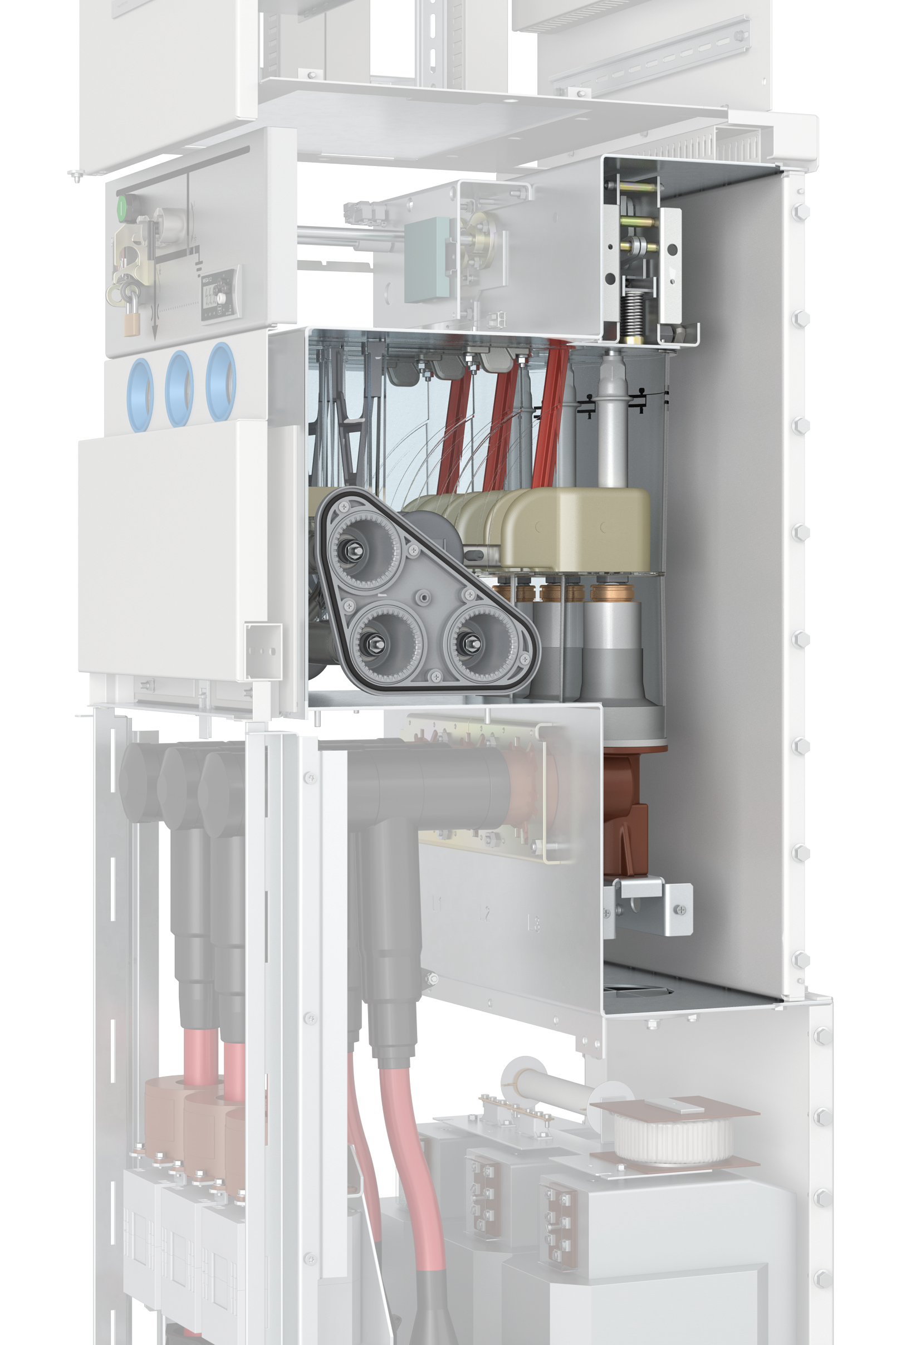
Xiria’s sealed for life compartment
Unlike arc quenching gas keeping designs Eaton’s Xiria’s sealed compartment is not intended to keep the arc-quenching gas inside.
Xiria’s sealed compartment is filled with dry air and by sealing this compartment the primary parts and tripping mechanism are protected from environmental influences such as moist, dust and any kind of animals or insects. By means of the sealed compartment the primary parts are maintenance free.
Where competitive switchgear relies on arc quenching gas to prevent from an internal arc Xiria is 100% gas free. With the benefit of maximized safety for personnel and our environment.
Note:
Any arc quenching gas keeping switchgear will loose its dielectric strength as soon as gas has leaked from the gas keeping compartment. Loosing dielectric strength potentially results in an internal arc while performing switching actions. As a result gas keeping switchgear designs are equipped with a manometer with the purpose of checking gas pressure level before switching.

Slide 20
Xiria’s sealed for life compartment
Design classification
GIS GIS SSIS GIS SIS AIS
Insulation medium
AIR + Solid
Novec (3M)
Solid +
Screen
SF6
Solid
AIR
Design concept
Sealed compartment
Sealed compartment
Metal-clad housing
Sealed compartment
Metal-clad housing
Metal-clad housing
Cost effectiveness
Technical feasibility
Energy efficiency
Reliability
Environmental friendliness
Safety
Footprint / Compactness
Total Cost of Ownership
😐
☺
☹
☺
☹
☺
☺
😐
☺
☺
☺
☺
☺
😐
☺
😐
☺
☺
☺
☺
☺
☺
☺
😐
Values
☺
☺
☺
☹
☺
☺
☺
☹
☺
😐
☺
😐
☺
☺
😐
☺
😐
☹
☺
😐
☺
😐
😐
😐
Xiria

Slide 21
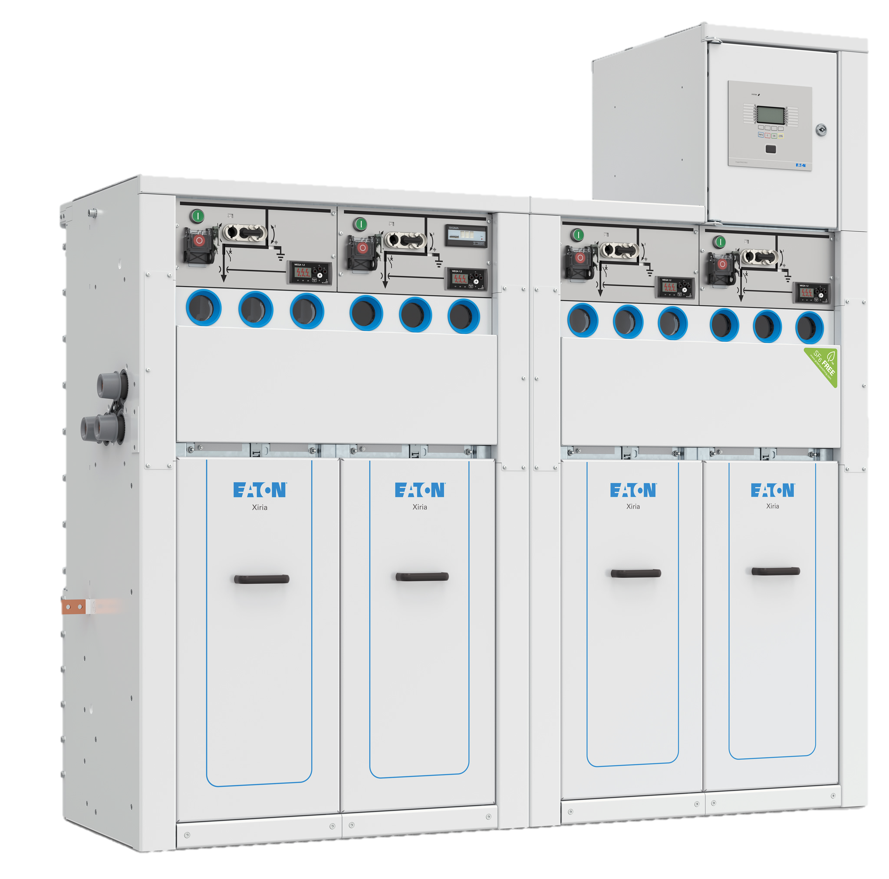
Xiria and flexibility
Flexible Product Family
Complete range of panel types
Extendable panel types available
Extensive list of options
Multiple configurations
Long history in engineering and integration of third party protection relays and Remote Terminal Units
Design allows for future extensions and upgrades

Slide 22
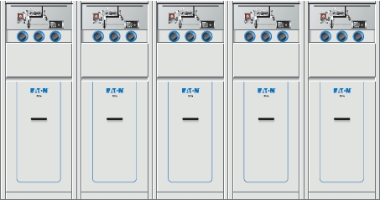
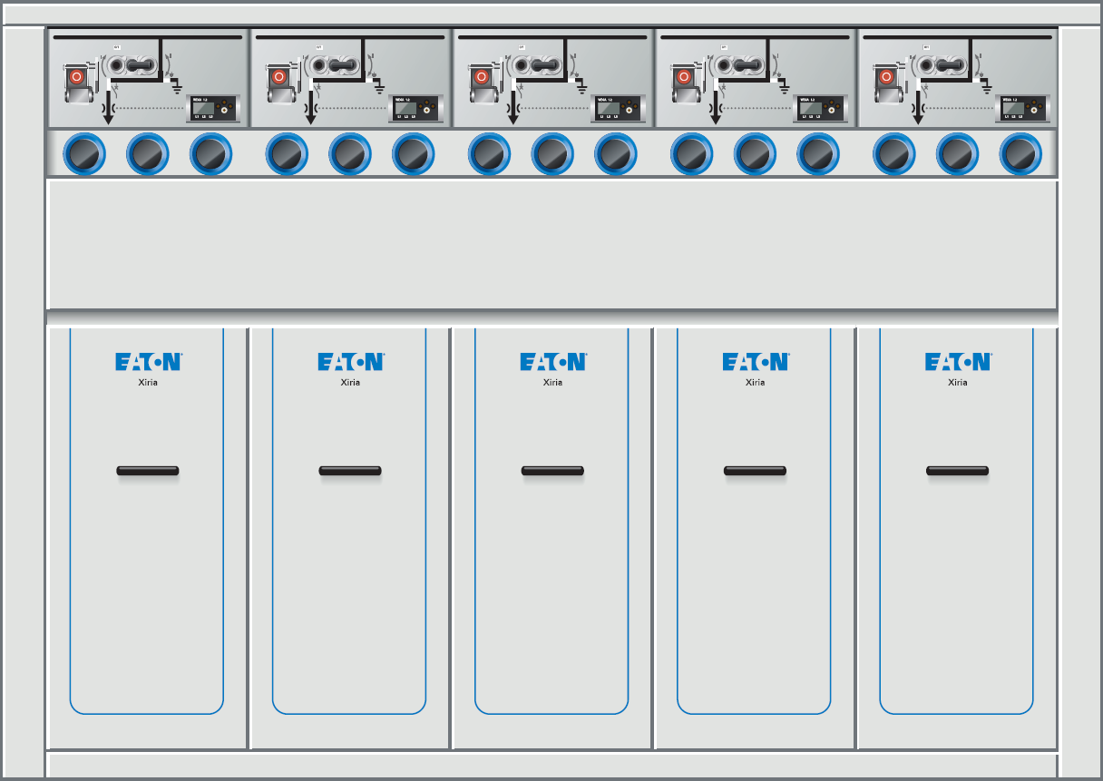
Xiria and compactness
Xiria extendible block saves 25% floor space when compared to single panel Xiria extendible
2500 mm width
1960 mm width
~25% saving

Slide 23
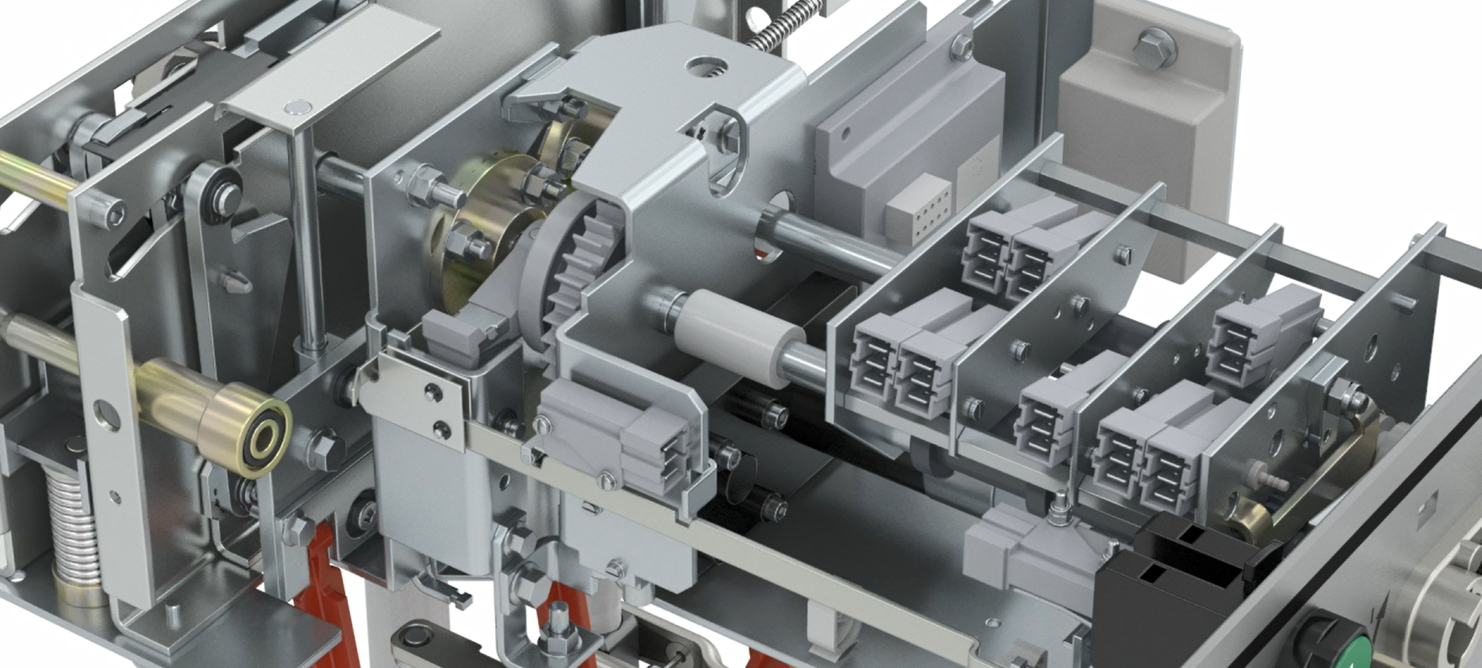
Xiria Product Family
Design details

Slide 24
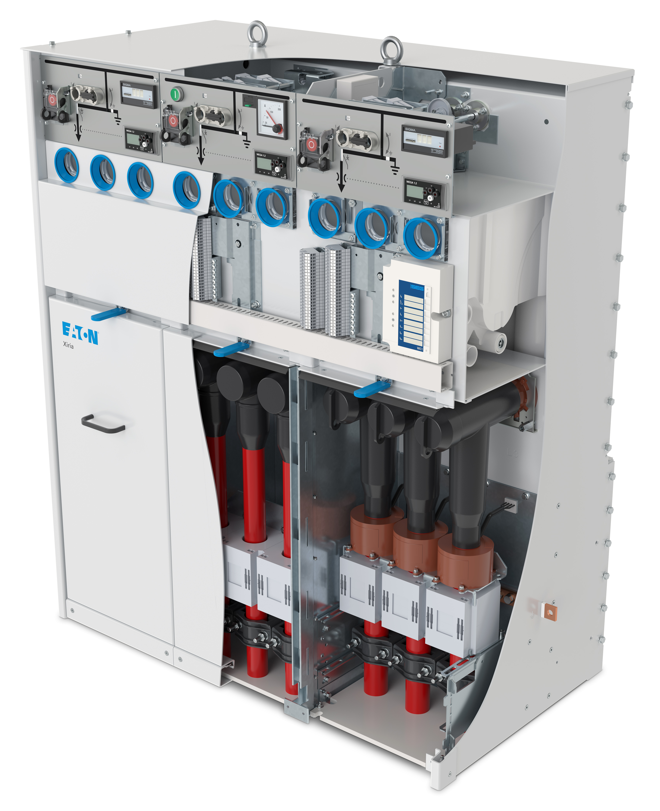
Xiria block version – Basic Design
2
3
5
Protection relay
Control panel
Mimic diagram
Voltage detection system
Inspection window
Cable cones
Cable clamps
Earth bar
4
1
6
8
7

Slide 25
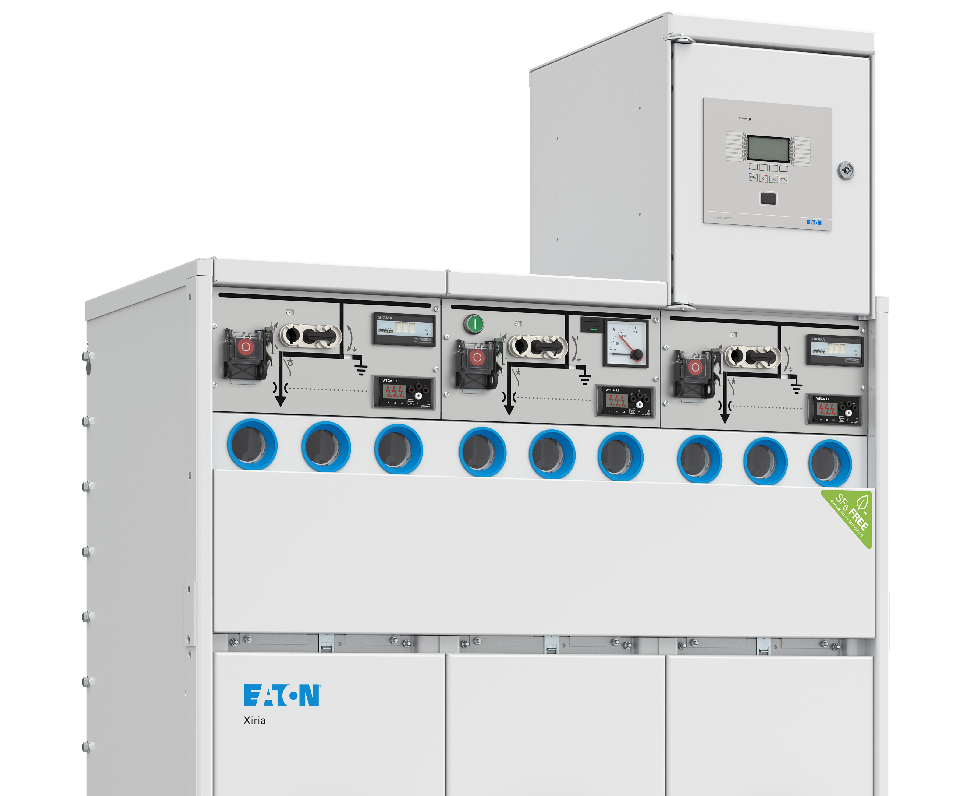

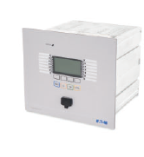

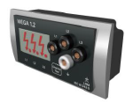
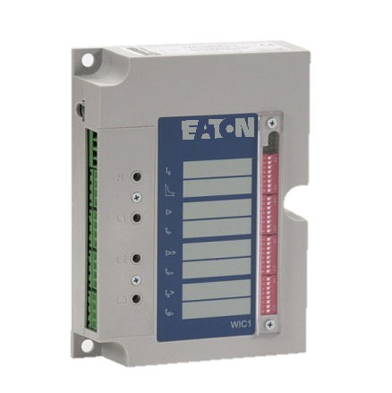
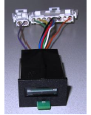
Intelligent devices embedded
Short-circuit indicator
Ampere meter
Advanced relay
Voltage detection system (VDS)
Self-powered relay
Trip indicator

Slide 26
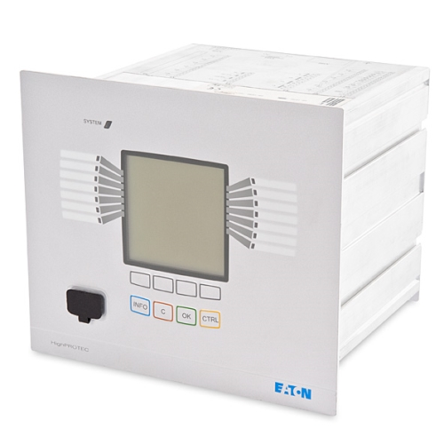
Products that meet your challenges
Protect people, assets and reputation
for business continuity
Design and build for resiliency
and sustainability
Lower risk with on-time project execution
and expertise
Protect people, assets and reputation
for business continuity
Product spotlight – Relays for protection and control
Range of safety and control relays suitable for Eaton low and medium voltage systems
Protection (MR-range) and Control (MC-range)
Extensive range including directional feeders, generator differential protection, motor protection and transformer protection
IEC 61850 compliant
All current and ground current inputs designed for 1 A and 5 A
Software for easy parameter setting
Multiple communication protocols including Modbus, Profibus, DNP3.0, IEC 61850 and IEC 60870-5-103
Notes:
Norbert Borgers

Slide 27
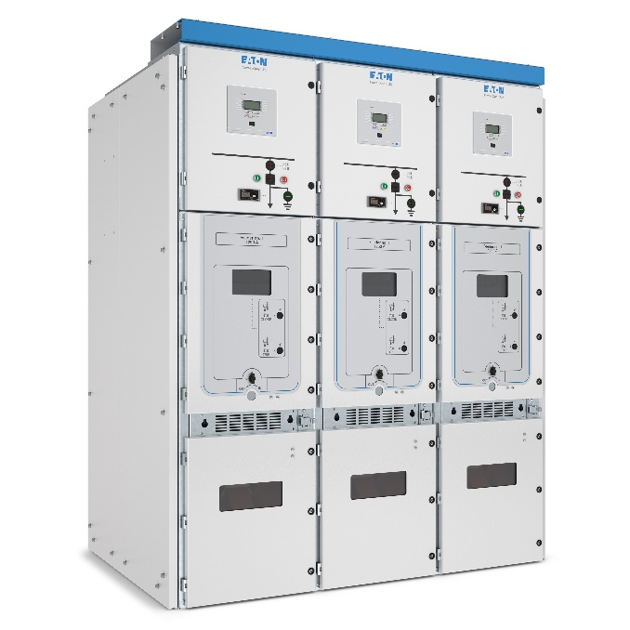

Power Xpert UXTM
Primary withdrawable switchgear system up to 24 kV
Notes:
To insert a new slide with this template, go to the Home tab (up top), click New Slide and select the one that says Impactful Slide.
Please avoid using this slide style too often in your presentation. It is meant to help get strong messages across and/or to help separate sections within your presentation.

Slide 28


Products that meet your challenges
Protect people, assets and reputation
for business continuity
Design and build for resiliency
and sustainability
Lower risk with on-time project execution
and expertise
Protect people, assets and reputation
for business continuity
Product spotlight – Power Xpert UX24
Withdrawable switchgear up to 24 kV
Safe, reliable and user friendly operation
Internal arc rating up to 50 kA during 1s
3rd party type tested according to IEC62271-200
SF₆-free design – no SF₆ disposal at end of life
Maximize service continuity through separate metal compartments LSC2B/PM
Fully insulated and isolated design to extend product life
Broad range of configurations and options including vacuum circuit breakers and contactors for maximum flexibility
Low total cost of ownership
Notes:
Arjan J Veehof

Slide 29
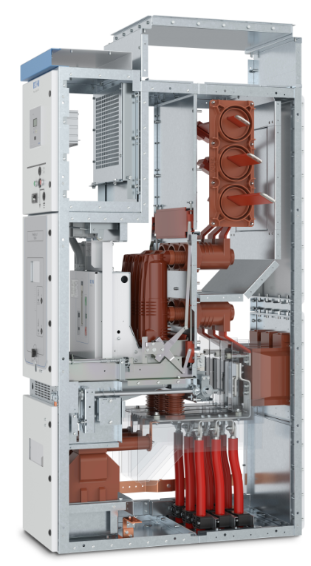
Power Xpert UXTM
Air insulated, withdrawable vacuum circuit breaker and contactor
Rated voltage 3.6/7.2/12/17.5 kV
  Current ratings up to 4000 A
  Short circuit levels up to 50 kA/3s
Rated voltage 24 kV
  Current ratings up to 2500 A
  Short circuit levels up to 31.5 kA/3s
Internal Arc Classification (IAC) – AFLR
  Up to 50 kA/1s (3.6/7.2/12/17.5 kV)
  Up to 31.5 kA/1s (24 kV)
Highest Loss of Service Continuity - LSC2B
Partition Class – PM
Degree of protection enclosure – IP4X (IP41, IP42 or IP44 option)
Notes:
To insert a new slide with this template, go to the Home tab (up top), click New Slide and select the one that says Title and Content.

Slide 30
Eaton Vacuum Interrupters
Eaton vacuum Circuit Breakers and Load Break Switches reliably switch currents and require minimal maintenance while enhancing safety
Features & benefits
Safe
Highly reliable
  MTBF: >100,000 years
Maintenance free
> 30,000 mechanical operations
> 100 short-circuit switching operations
Compact

Slide 31
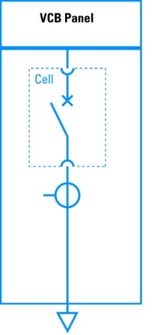
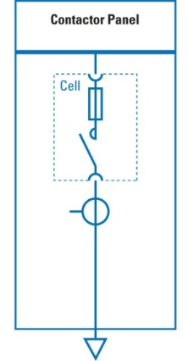
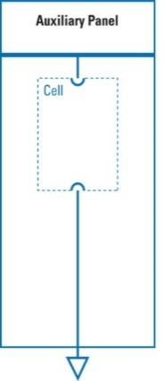
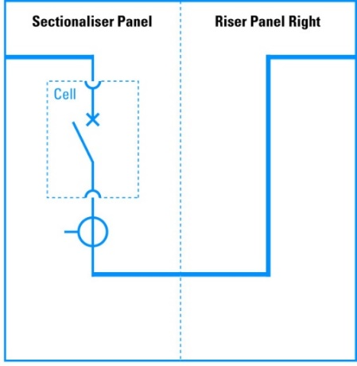
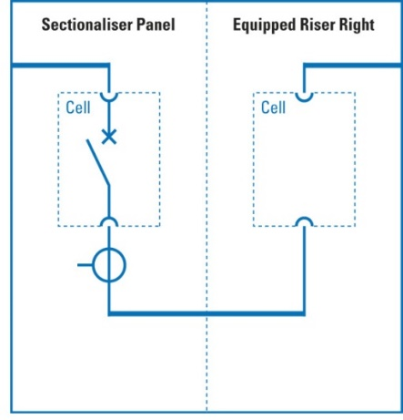
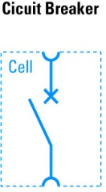
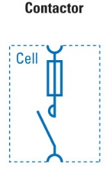
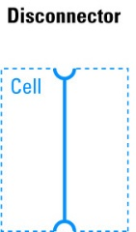
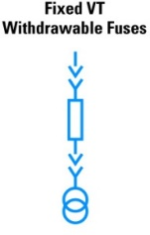
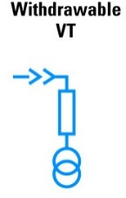

Panel typicals standard
3
5
6
6
3
6
6
5
4
4
4
5
4
4
For other available options, please contact Eaton
1
2
3
4
5
6

Slide 32
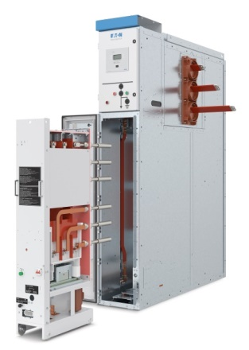
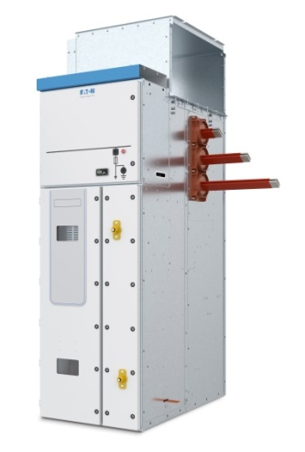
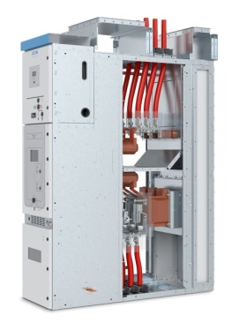
Panel typicals special
Slimline contactor 315/400 A up to 7.2 kV (400 mm panel width)
Fused loadbreak switch fixed up to 24 kV
Single width panel solutions with cables in/out (top/bottom, top/top)
------>

Slide 33
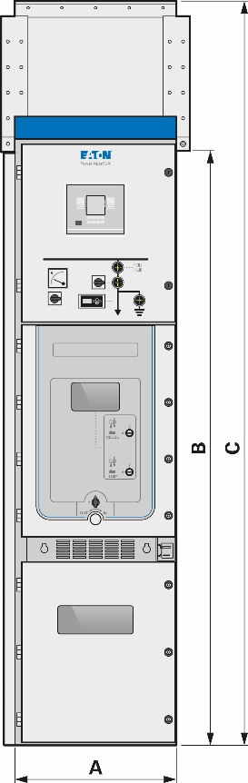
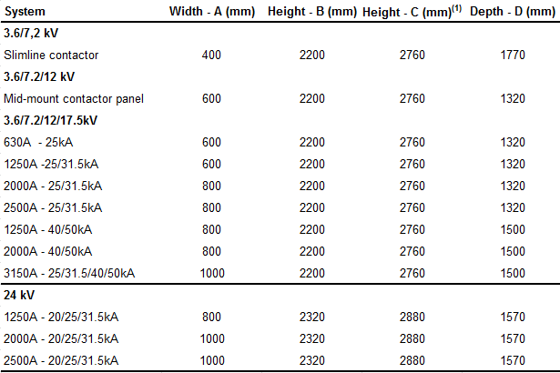
Main dimensions Power Xpert UX
⁽¹⁾ Total height with standard arc channel for venting gases outside the switchroom. For the availability of low height arc channels and solutions for arc exhaust inside the switchroom, please contact Eaton.

Slide 34

Power Distribution Division and MV switchgear

Slide 35

www.eaton.com
Notes:
Uk portfolio:
http://www.eaton.uk.com/EatonUK/ProductsSolutions/Electrical/ProductsServices/PowerDistributionMonitoring/index.htm

